Slide 1
SALES_DATA POWER BI
Presented by Shanmukhi Koshireddy
Designed for Business Insights & Decision Support
Date : 05-06-2025

Slide 2
Agenda
03 | Objective
04 | Dataset overview
05 | Tools and Techniques
06 | Dashboard overview
08 | Drawn Insights

Slide 3

OBJECTIVE
To build an interactive dashboard using Power BI.
Enable stakeholders to analyze key sales metrics.
Visualize trends across time, regions, and products.

Slide 4
About Dataset
Dataset: sales_data_sample.csv (from Kaggle)
SIZE : 2823 records, 25 columns
Key Fields:
SALES, ORDERDATE, PRODUCTLINE, COUNTRY, DEALSIZE, MONTH_ID, YEAR_ID, TERRITORY

Slide 5
TOOLS AND TECHNIQUES
Utilized Power BI Desktop for data visualization
Created Calculated Columns for custom metrics
Applied Filters for focused insights
Maintained a Consistent Theme & Layout for clarity
Visuals Used: - Cards for KPIs - Tables for detailed data - Gauge for performance tracking - Donut Chart for category breakdown
Delivering actionable insights with clean, interactive design

Slide 6
DASHBOARD OVERVIEW 📈 BAR Chart – QUANTITY ORDERED BY PRODUCT LINE 📊 COLUMN Chart – Sales by TERRITORY 🍩 Donut Chart – ORDER QUANTITY BY COUNTRY 🔲 KPI Cards – SUM OF SALES BY STATUS,SUM OF SALES BY DEALSIZE 🔄 FUNNEL – ORDER LINE BY MONTH 📋 TABLE – DEALSIZE BY YEAR AND MONTH 🎚️ GUAGE – ORDERLINE NUMBER

Slide 7
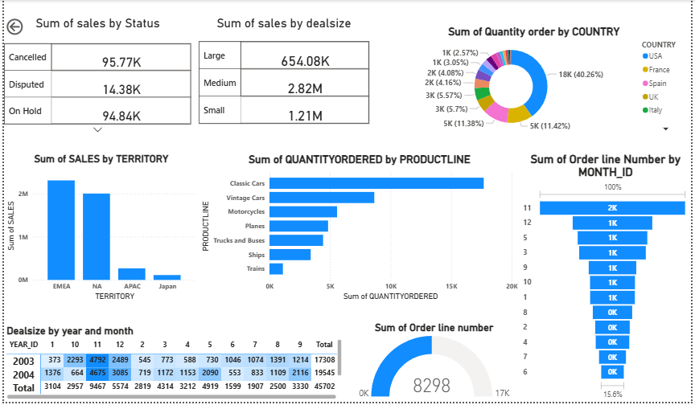

Market comparison
Stands out in market
Innovative features
Provides unique solution
Edge over competitors
User-focused design
Prioritizes user experience

Slide 8
DRAWN INSIGHTS
More number of sales is gained from EMEA (Europe,Middle EAST, Africa).
More number of quantiy ordered is received in the month of November and then December by Classic cars.
Higher number of quantiy order is from state USA.
Most customers are ordering in medium dealsize.
In the month of June number of order line is very small i.e max is 572.
Year by year quantity ordering is increasing.

Slide 9
THANK you
Shanmukhi koshireddy

